Slide 1
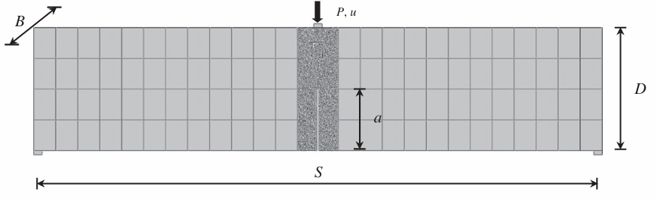
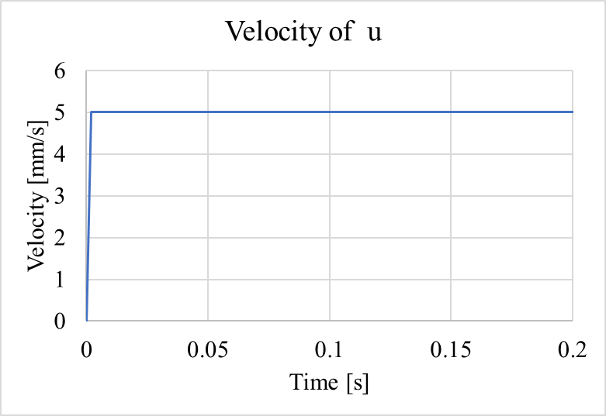
TPB Test
S = 1151 mm
D = 200 mm
B = 100 mm
a = 100 mm
Notch width = 4 mm
u = 5mm/s
0.002

Slide 2
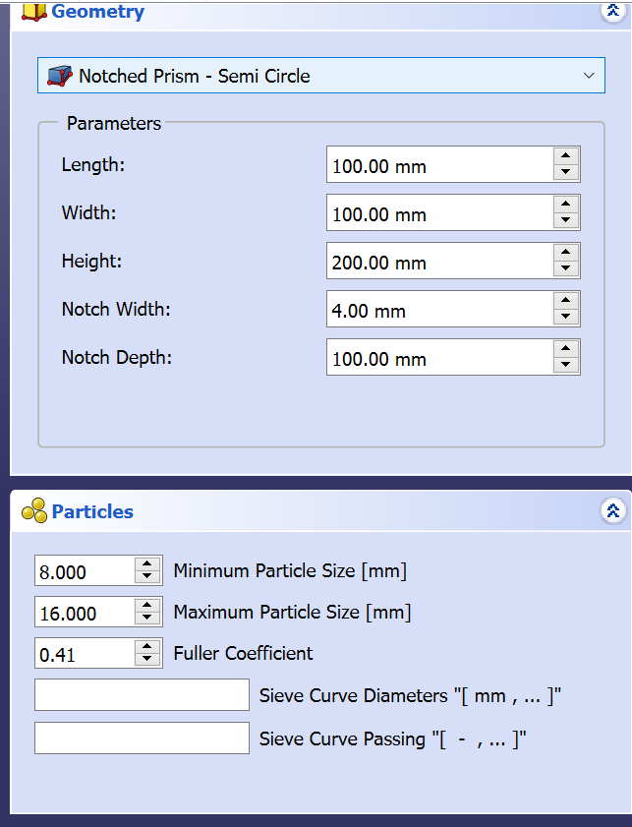
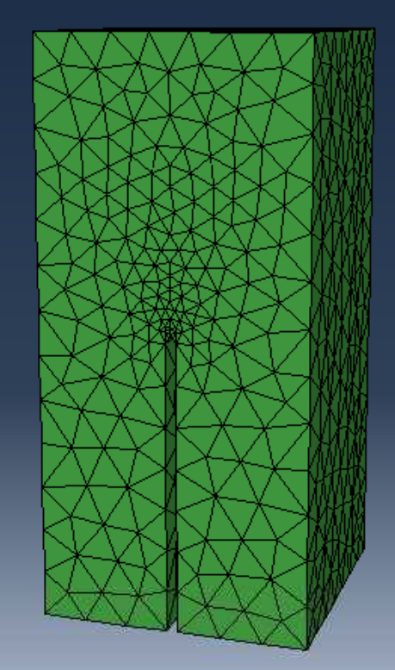
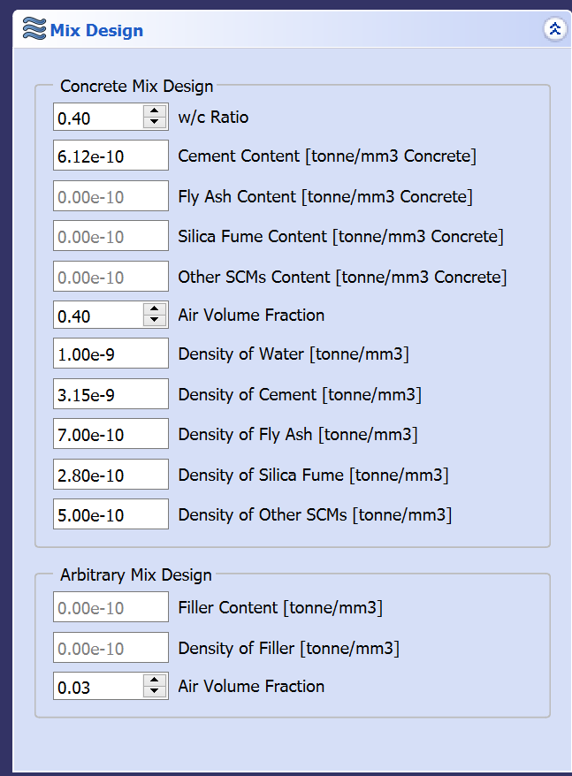
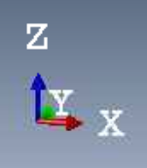
LDPM Part
Size in XYZ: 100mm x 100mm x 200mm
Generated using FreeCAD
Mesh information is stored in LDPM mesh folder
Folder:
LDPM mesh 8-16:
Minimum particle size is 8mm
Maximum particle size is 16mm
LDPM mesh 5-16:
Minimum particle size is 5mm
Maximum particle size is 16mm

Slide 3
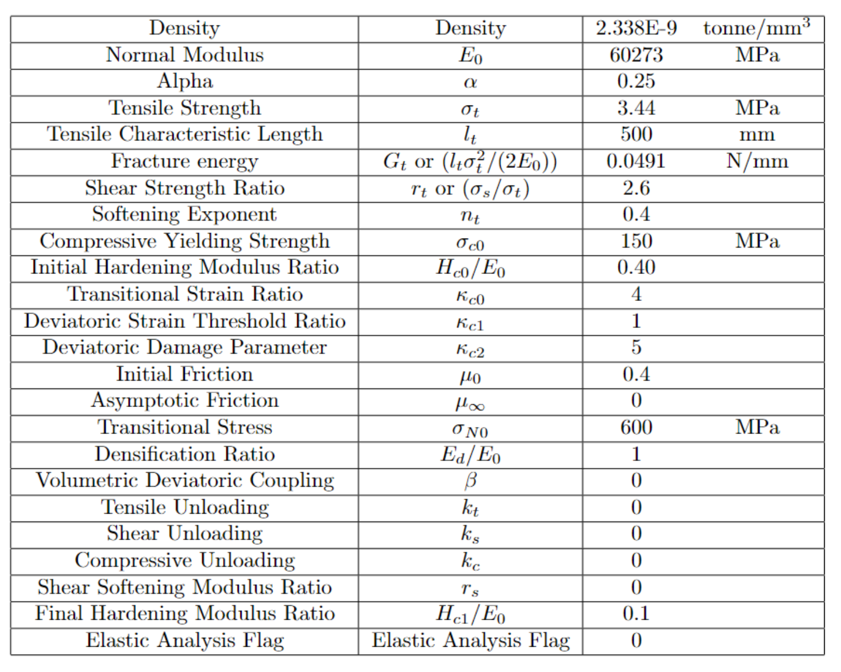
LDPM Part
Material Property:

Slide 4
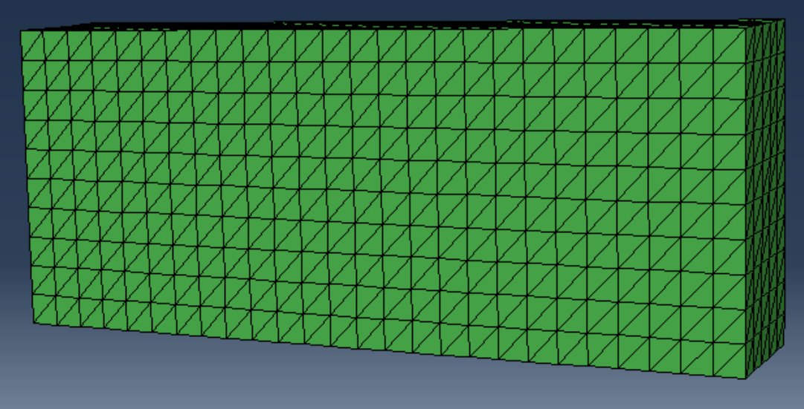
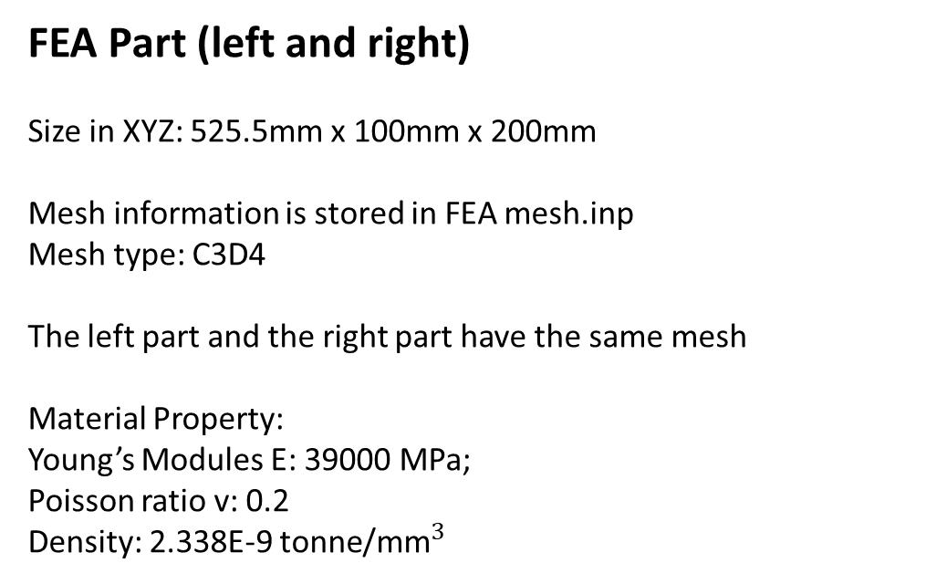
FEA Part (left and right)
Size in XYZ: 525.5mm x 100mm x 200mm
Mesh information is stored in FEA mesh.inp
Mesh type: C3D4
The left part and the right part have the same mesh
Material Property:
Young’s Modules E: 39000 MPa;
Poisson ratio v: 0.2
Density: 2.338E-9 ${\text{tonne}\text{/}\text{mm}}^{3}$

Slide 5
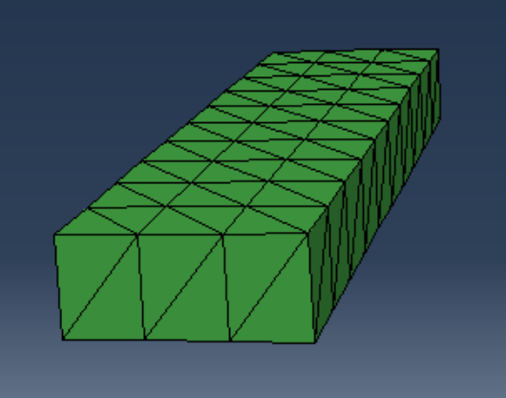
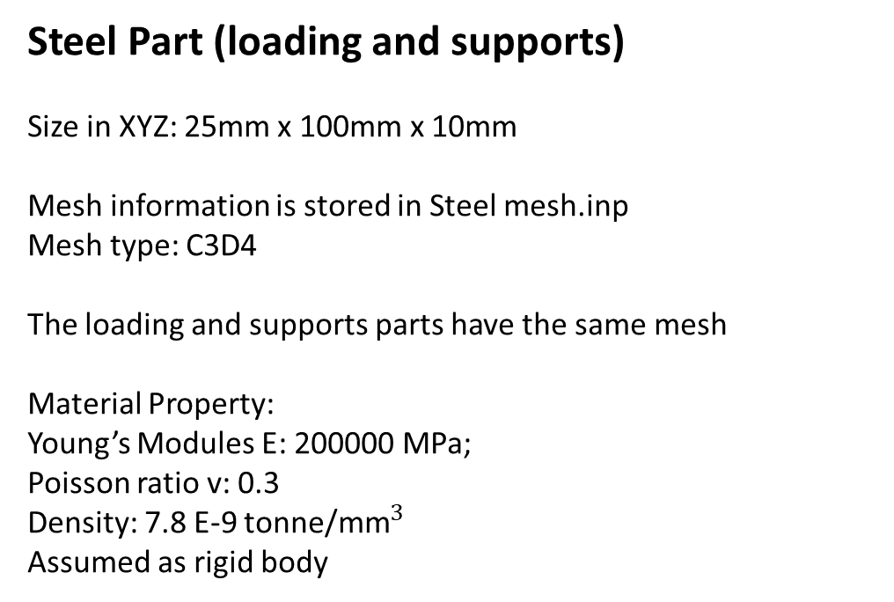
Steel Part (loading and supports)
Size in XYZ: 25mm x 100mm x 10mm
Mesh information is stored in Steel mesh.inp
Mesh type: C3D4
The loading and supports parts have the same mesh
Material Property:
Young’s Modules E: 200000 MPa;
Poisson ratio v: 0.3
Density: 7.8 E-9 ${\text{tonne}\text{/}\text{mm}}^{3}$
Assumed as rigid body

Slide 6
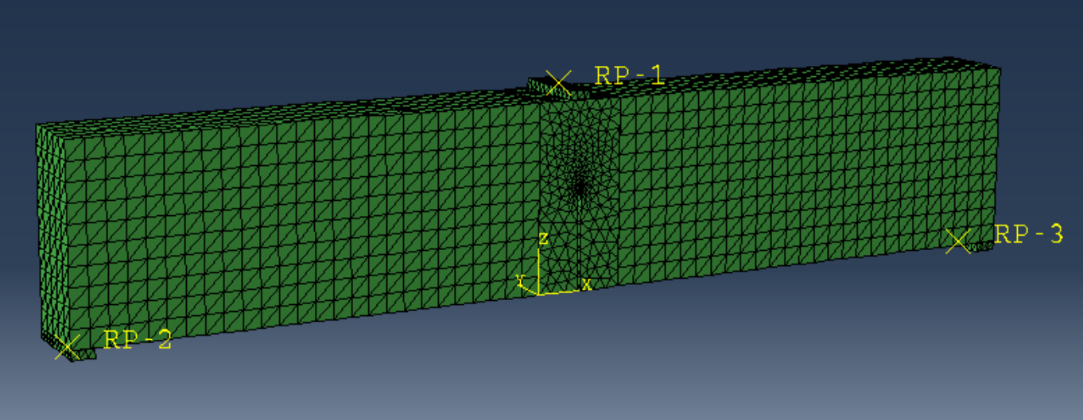
Tie
Tie
Tie
Tie

Slide 7
Boundary Condition
RP-1: dx = 0; dz = applied displacement
RP-2: dz = 0
RP-3: dz = 0

Slide 8
